Slide 1

Welcome
On your tables you will find copies of a Key Stage 2 Maths Arithmetic Paper.
This is what we expect our 11 year olds to be able to complete by the time they leave us.
Can you complete the paper?
Have a go while we are waiting for everyone to arrive!

Slide 2
Bledlow Ridge School
Maths Calculation Workshop for Parents
21st November 2019

Slide 3
Aims of the Workshop
To outline the main areas and expectations of the Primary Maths Curriculum.
To provide parents with ideas and activities that they can use at home to support children’s maths development.
To outline the clear progression of the four calculation methods and how these are taught at BRS.

Slide 4
Key Aims of the Maths Curriculum
Fluent recall of mental maths facts e.g. times tables, number bonds etc.
To reason mathematically – children need to be able to explain the mathematical concepts with number sense; they must explain how they got the answer and why they are correct.
Problem solving – applying their skills to real-life contexts.

Slide 5
Key Expectations of the Maths Curriculum:
Five-year-olds are expected to learn to count up to 100 (compared to 20 under the previous curriculum) and learn number bonds to 20 (previously up to 10).
Simple fractions (1/4 and 1/2) are taught from KS1, and by the end of primary school, children should be able to convert decimal fractions to simple fractions (e.g. 0.375 = 3/8).
By the age of nine (Year 4), children are expected to know times tables up to 12×12 (this is now tested).

Slide 6
Calculation at Bledlow Ridge
Aims
• To ensure consistency and progression in our approach to calculation.
• To ensure that children develop an efficient, reliable, formal written method of calculation for all operations.
• To ensure that children can use these methods accurately with confidence and understanding.

Slide 7
Good Practice in Maths Today!
Mental calculation skills are vital.
Children need the ability to estimate.
e.g. If I have 18 sweets in one bag
and 33 sweets in another bag,
how many do I have altogether?
Children can estimate by adding 20 and 30 and know that roughly the answer should be around 50.

Slide 8
Good Practice in Maths Today!
All children need to learn maths in a real life context.
As well as knowing 7x7=49. Children need to be able to do the following:
There are 7 fields.
Each field has 7 sheep in them.
How many sheep are there in total?
Children need to be able to explain how they have calculated or solved a problem.
In the Maths curriculum, written calculations are taught at an earlier age than previously. The mental methods are essential for supporting pupils understanding of these written calculations.

Slide 9
Good Practice in Maths Today!
Connections are made between mathematics topic areas, other subjects and between objectives.
Children are taught to reason mathematically so that they able to consider if their answers are plausible.
Children are taught to consider the most effective calculation method and approach to calculations.

Slide 10
Do we follow a scheme?
All Year Groups follow planning from the White Rose Maths Hub.
This provides an outline structure and lesson sequences.
Teachers use these resources plus a range of other resources to plan and teach sequences of lessons.

Slide 11
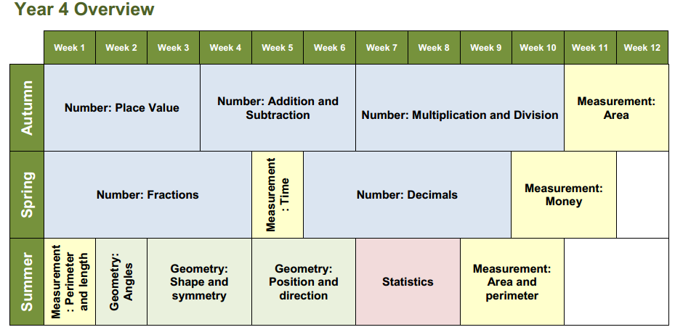
This ensures progression through the school.

Slide 12

Counting - a cornerstone of mathematical learning
Counting of objects and mental counting. This will include songs and rhymes, games and a range of practical activities.
You have five apples and I have three apples.
How many apples altogether?

Slide 13
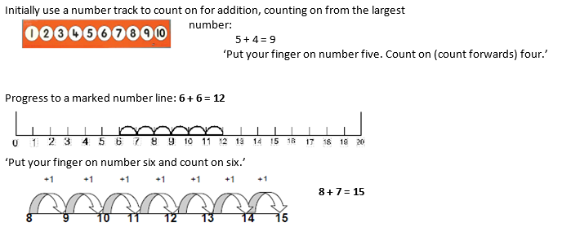
Addition

Slide 14


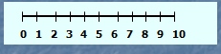
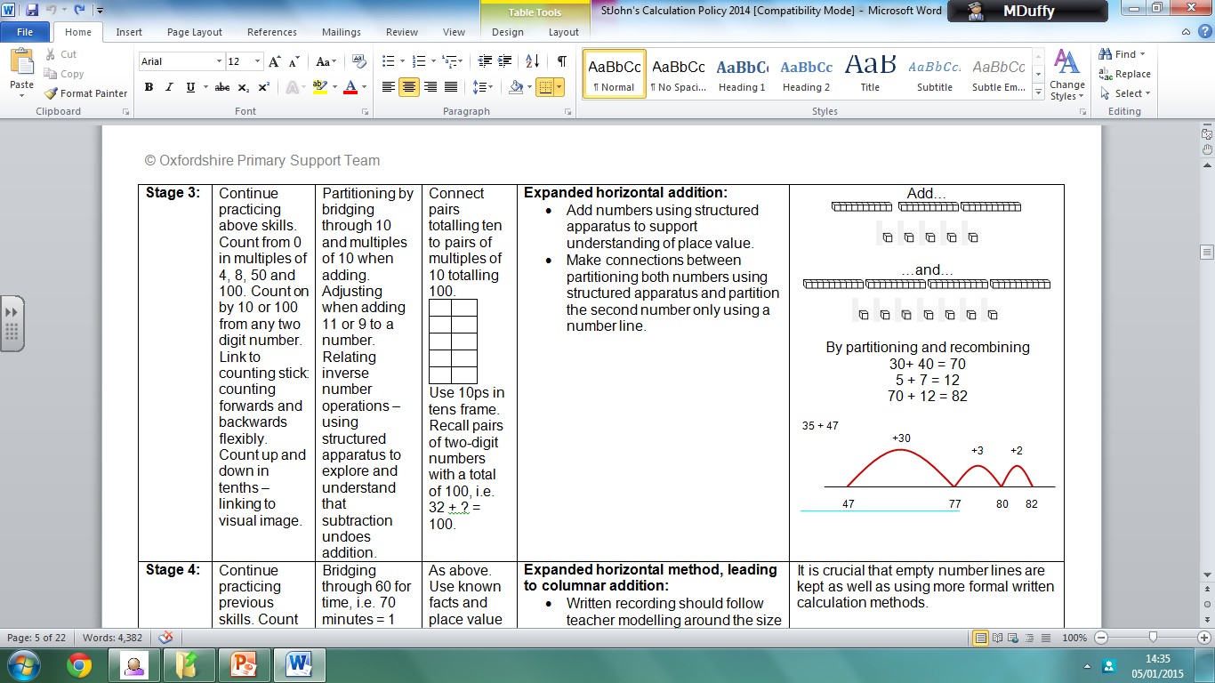
Addition
Practical addition of real objects.
Use of a structured number line to add.
Partitioning to add.
100
100
3
20
3
20

Slide 15
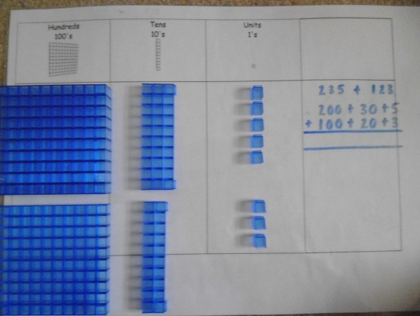
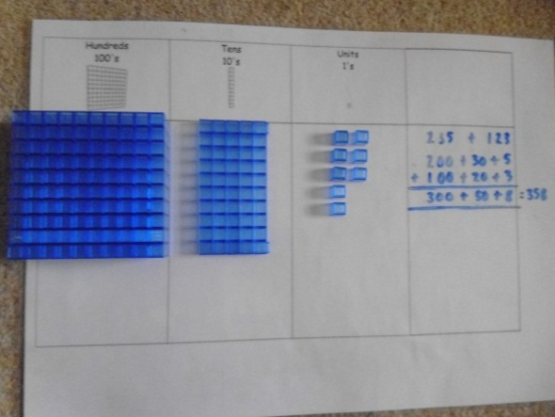
Addition continued…
+10
+10
+10
+2
+5
Use of an unstructured number line.
Expanded horizontal method, leading to columnar addition.
48
58
68
78
80
85

Slide 16
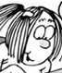
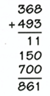

Informal written methods, first with whole numbers and decimals.
76 + 47 =
76 + 40 +7 =
116 + 7 = 123
Formal written methods.
With any calculation, teach children to consider first whether a mental method is appropriate and remembering to estimate first.
I must remember to add the least significant digit first
Remember to partition
(8+3)
(60+90)
(300+400)

Slide 17
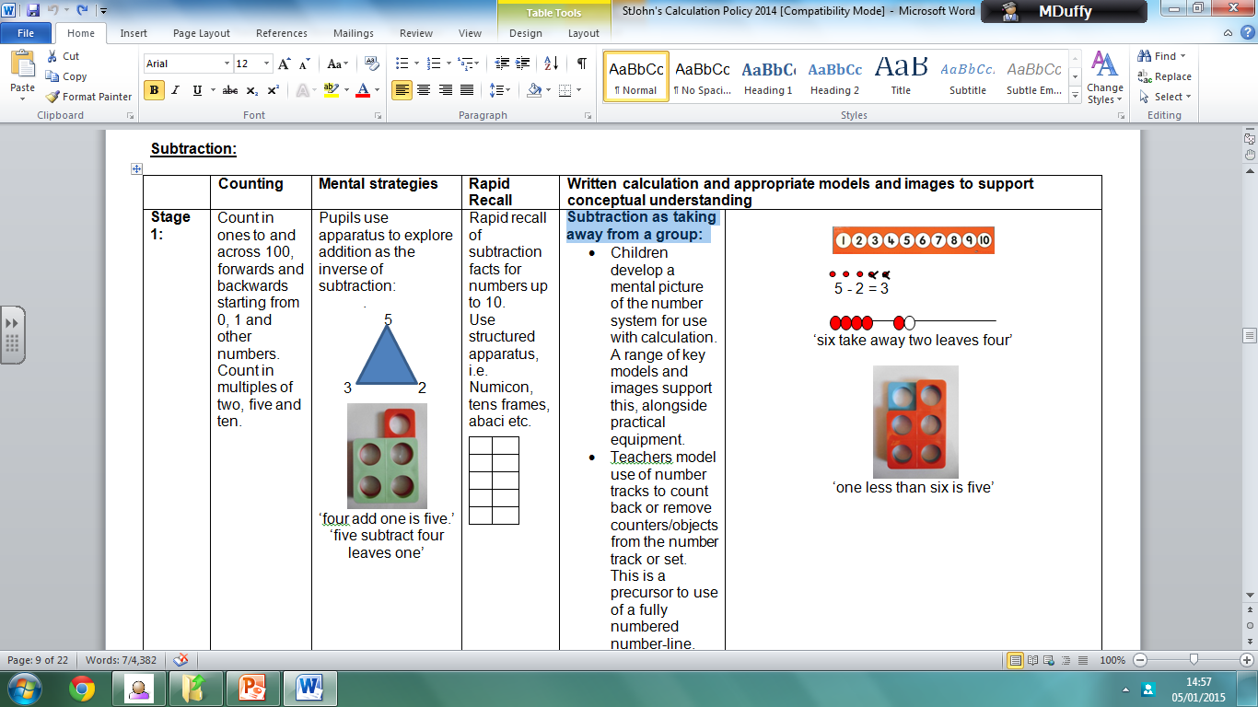
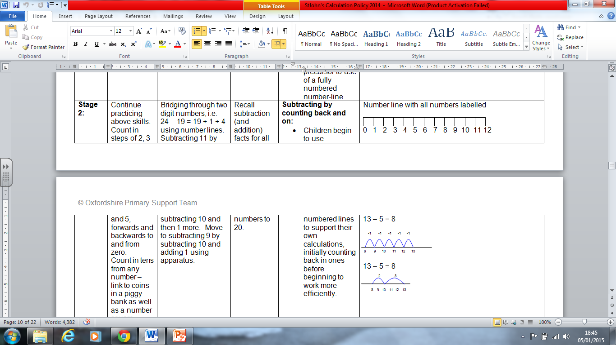
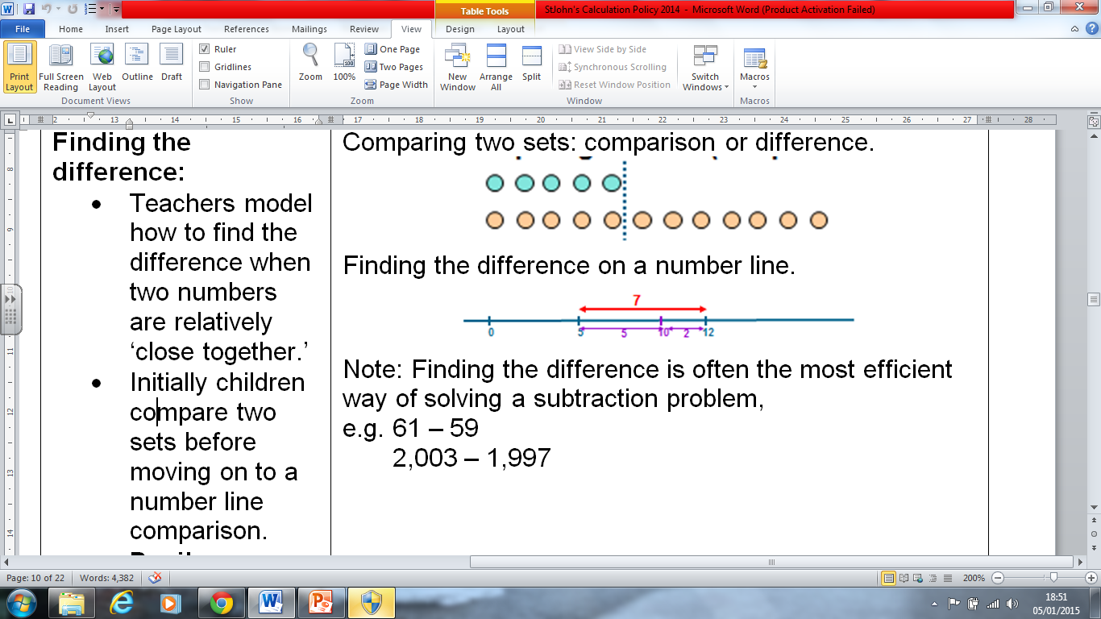
Subtraction
Subtraction as taking away from a group:
Subtracting by counting back and on: children begin to use numbered lines to support their own calculations, initially counting back in ones before beginning to work more efficiently.
Finding the difference by either counting on or back.

Slide 18
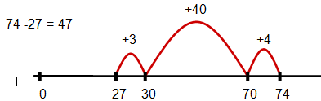
Subtraction continued…
Subtracting TU – U and TU – TU: use of an unstructured number line.
Use empty number lines to find the difference by bridging through multiples of ten.
Subtract by starting with the first number and partitioning the second, i.e.
74 - 27
74 – 20 = 54
54 – 4 = 50
50 – 3 = 47

Slide 19
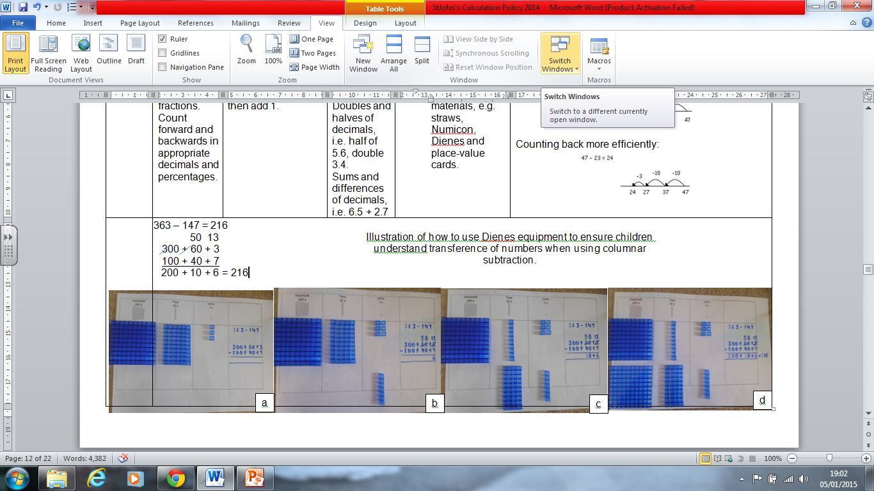
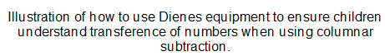
Subtraction continued…
First stage of column method, including expanded method:
•Written recording should follow teacher modelling around the size of numbers and place value using a variety of concrete materials, e.g. straws, Dienes and place-value cards.

Slide 20
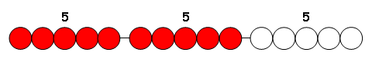
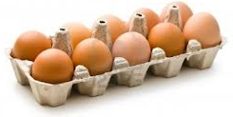
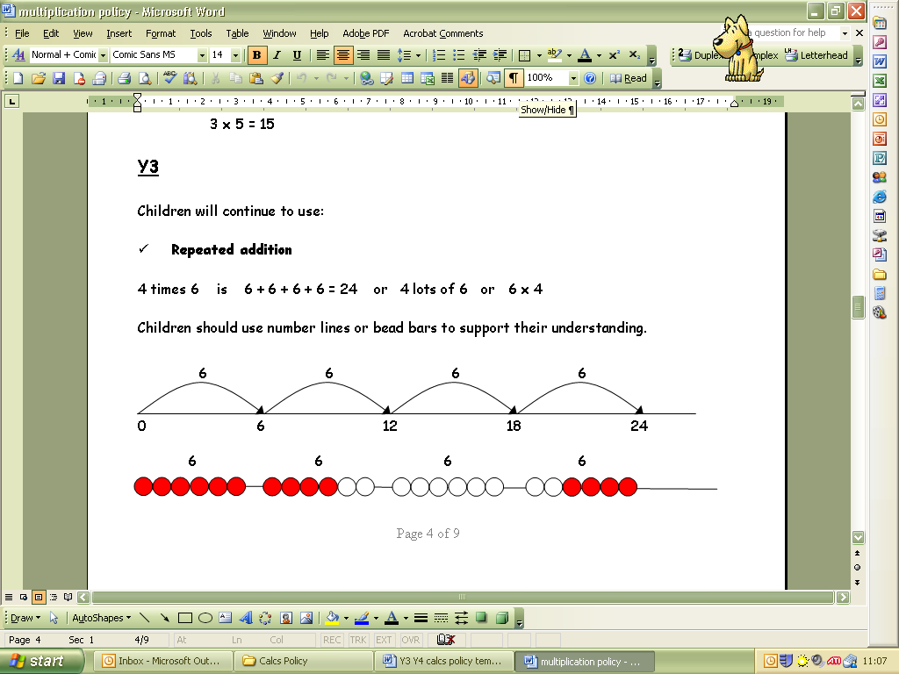
Multiplication
Developing early conceptual understanding of multiplication: practical multiplication - 2 x 4 2 lots of 4.
2. Understanding multiplication as repeated addition: use of arrays and number lines. 4 x 5
Number lines:
6 X 4 = 24
So: ‘Six taken four times”

Slide 21
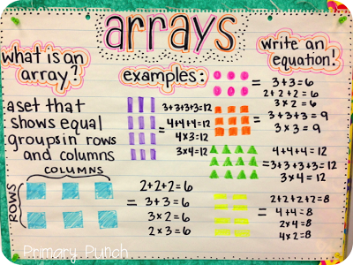
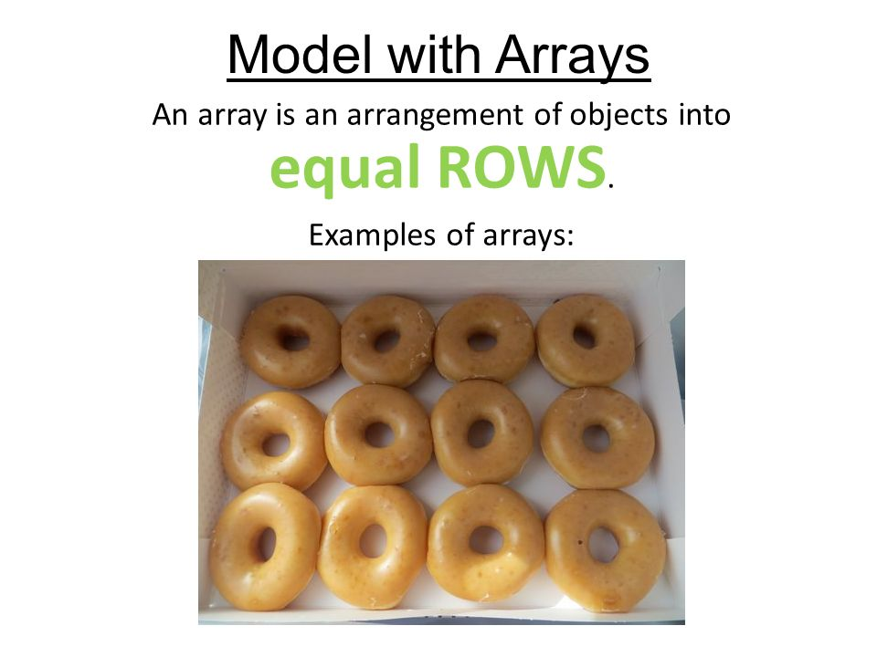
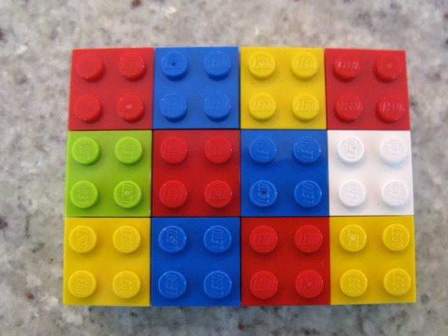
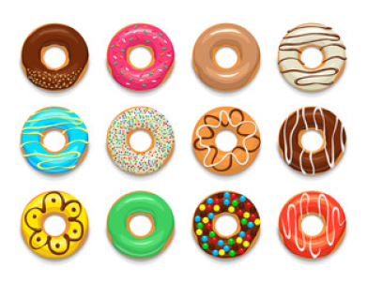
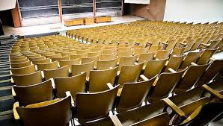
Multiplication - arrays

Slide 22
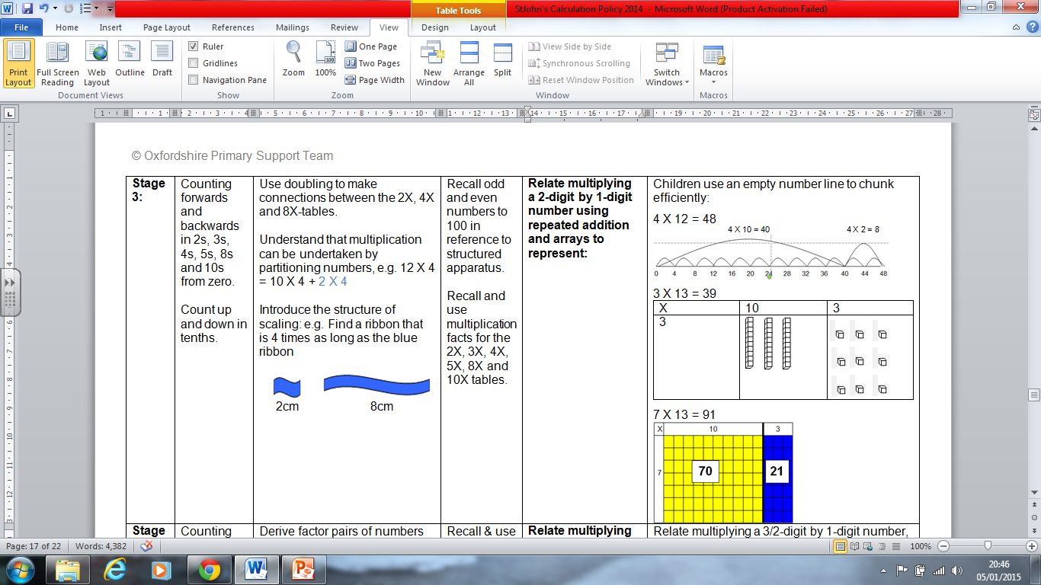
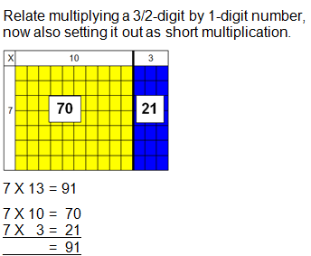
Multiplication
3. Relate multiplying a 2-digit by 1-digit number using repeated addition and arrays to represent
4. Relate multiplying a 3/2-digit by 1-digit number with arrays towards
using long/short multiplication

Slide 23
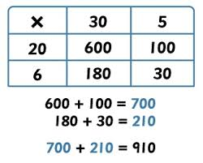
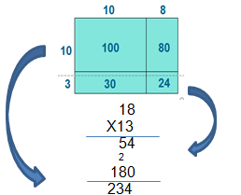
Multiplication
5. Relate multiplying a 4/3/2-digit by 1/2-digit number with grid to using long multiplication.
6. Relate multiplying a 4/3/2-digit by 1/2-digit number with grid to using short multiplication.

Slide 24
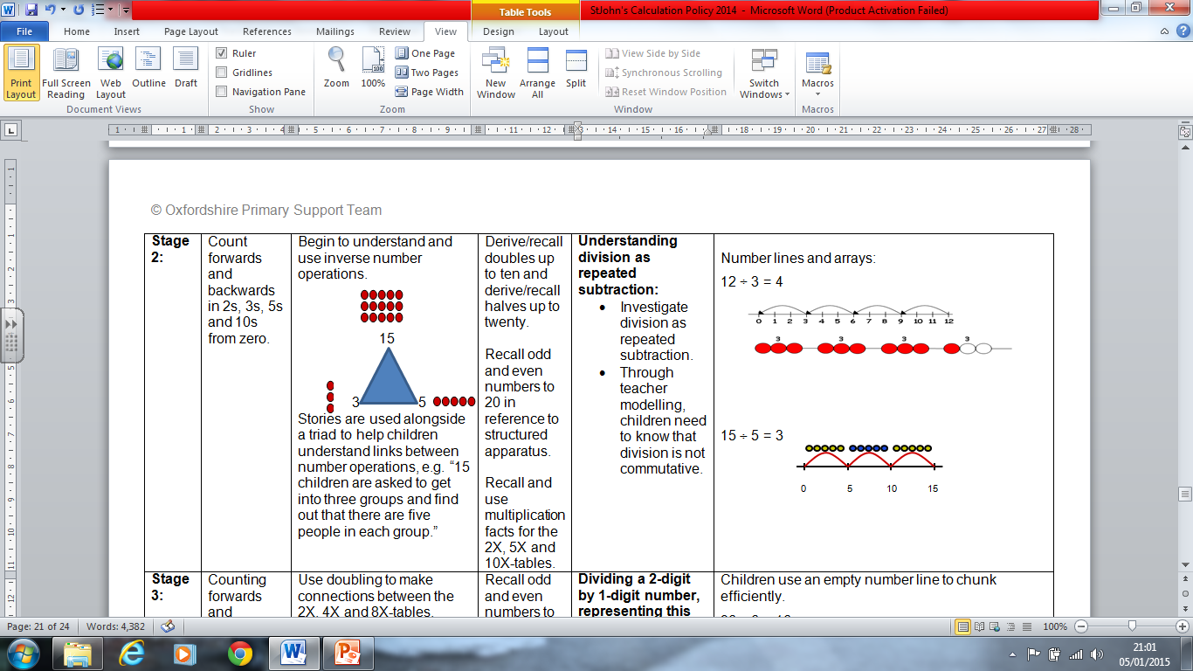
Division
Sharing or Grouping – Division is initially represented pictorially.
6 sweets shared between 2 people. How many each?
There are 6 people in a room. Put them into groups of 2.
How many groups can you make?
2. Using a number line and arrays to
show division.
6 ÷2 = 3

Slide 25
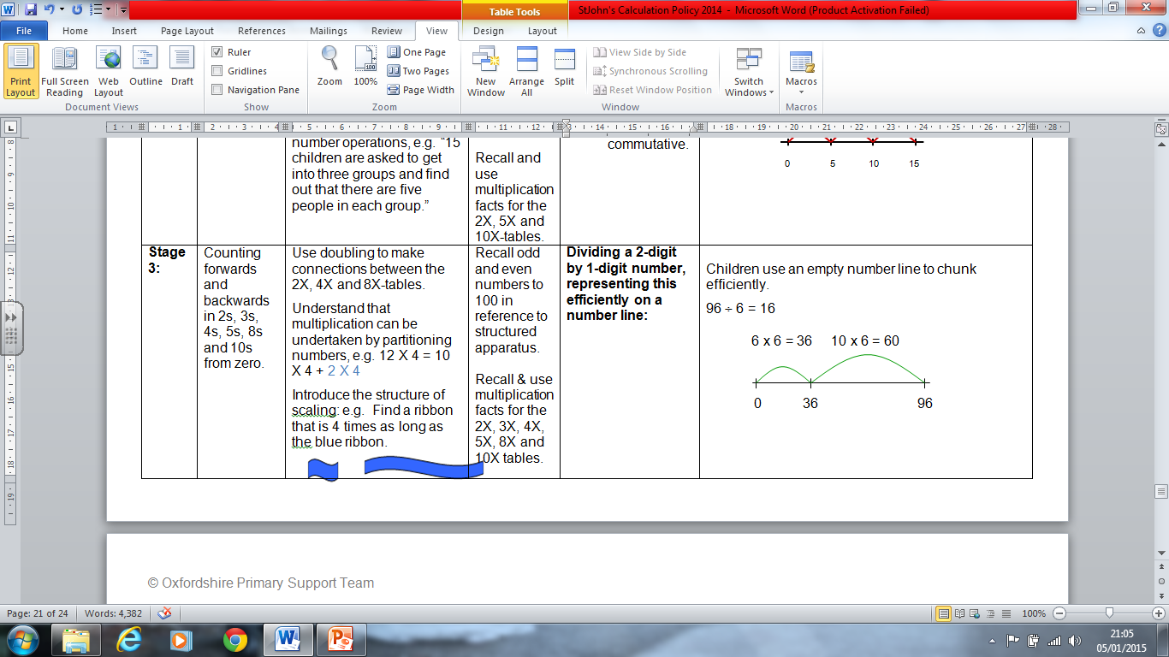
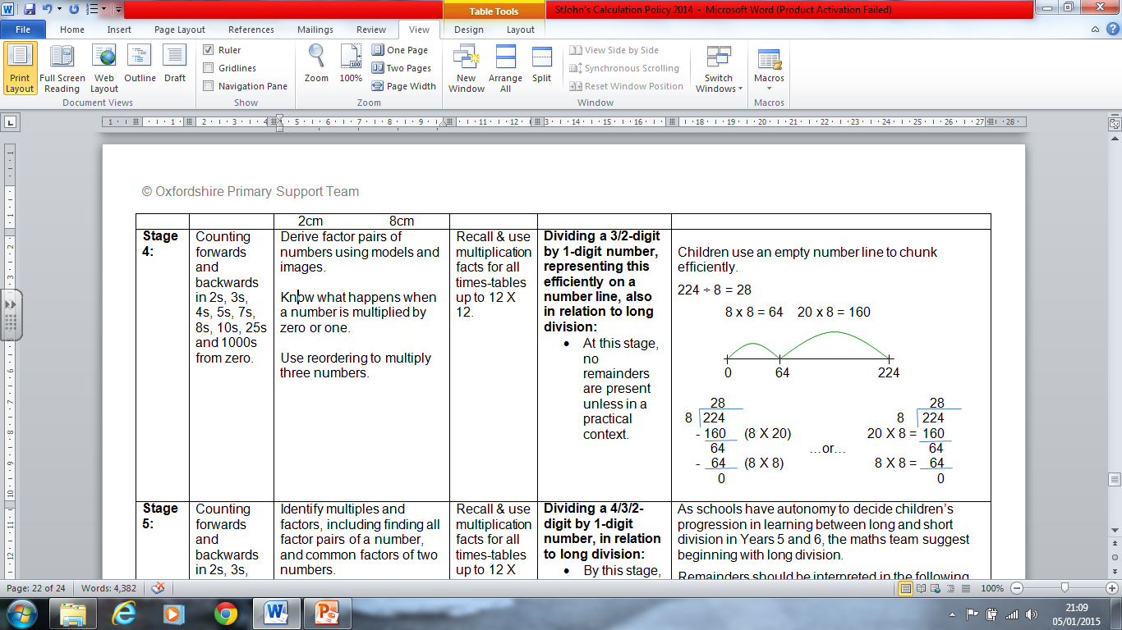
Division continued…
3. Dividing a 2-digit by 1-digit number, representing this efficiently on a number line.
4. Dividing a 3/2-digit by 1-digit number, representing this efficiently on a number line, also in relation to long division

Slide 26
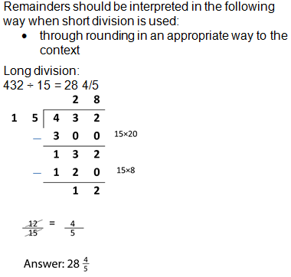
Division continued…

Slide 27
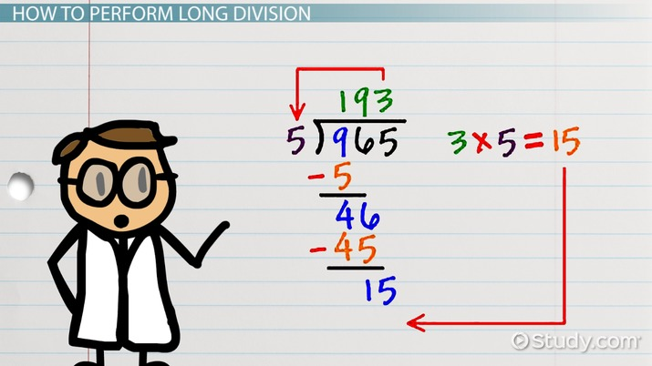
Division continued…

Slide 28
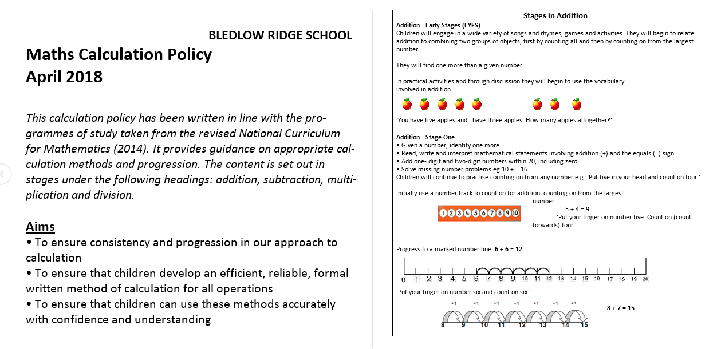
Our Calculation Policy
Our full calculation Policy is available on the school website.
Some copies are available for you to take home tonight.

Slide 29
Other ideas…
The Bar Model
This is a highly effective way of visualising calculations.

Slide 30
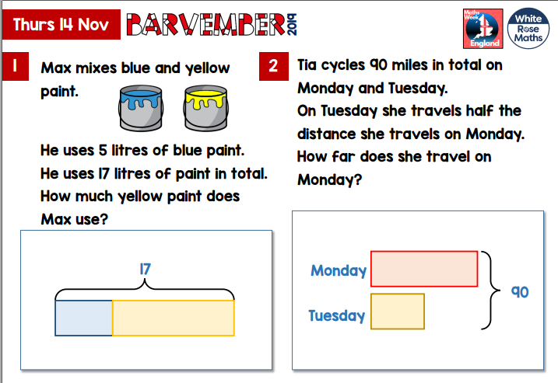

Slide 31
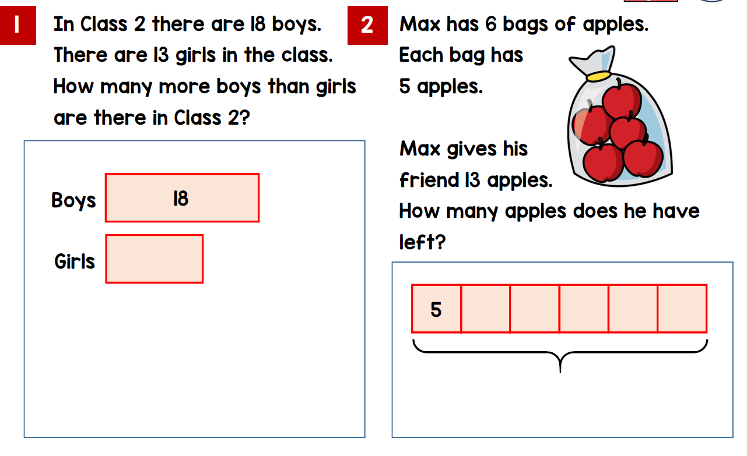
Other ideas…

Slide 32
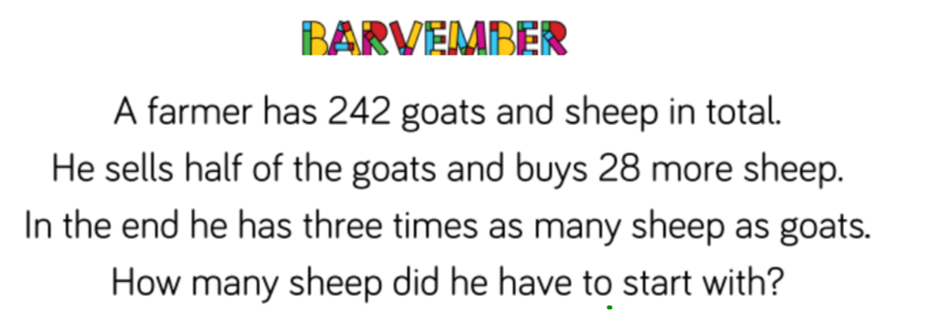

Slide 33
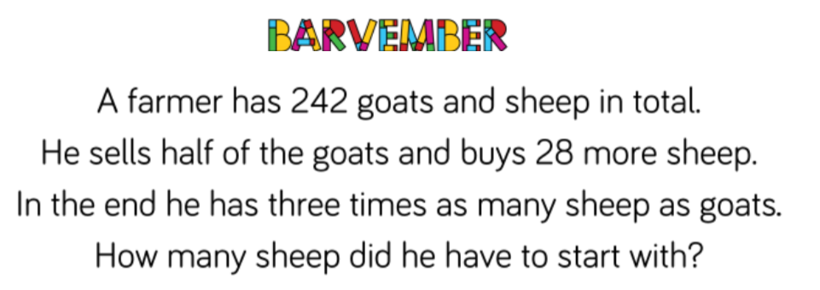
Other ideas…
Try this example from White Rose Barvember activities:

Slide 34
Final Challenge!
Can you solve this problem?
Ralph posts 40 letters, some of which are first class and some of which are second class.
He posts four times as many second class letters as he does first.
How many of each does he post?

Slide 35
Final Challenge!
And that was a GCSE higher paper question!
I hope you have found this evening useful and enjoyable.
Safe journey home!

