Slide 1
Sustainability
What does this mean and why is it so important?

Slide 2
Sustainability
Is building things to last.
Humans must interact with the environment in a way that ensures there will be enough resources left for future generations.
What school values does this link to?

Slide 3
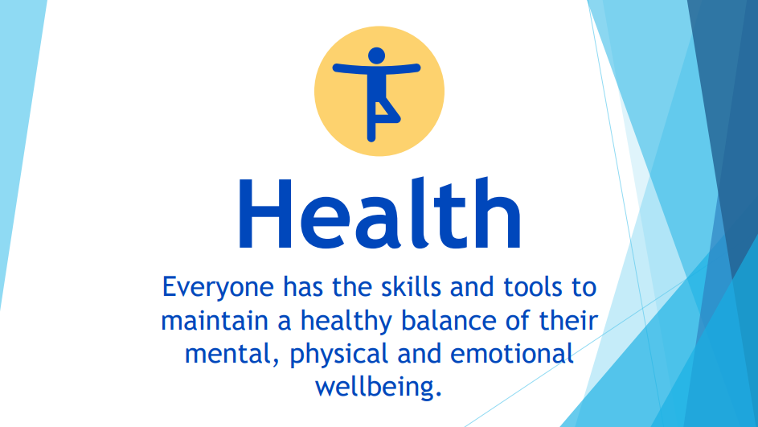

Slide 4


Slide 5
Think about your day so far. How much rubbish have you already produced?
What rubbish might you produce later in the day?
How much rubbish you have produced this week?

Slide 6
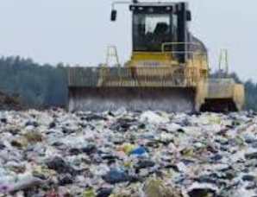
Where does this rubbish end up?
A landfill site is an area of land that is used to dump rubbish.

Slide 7
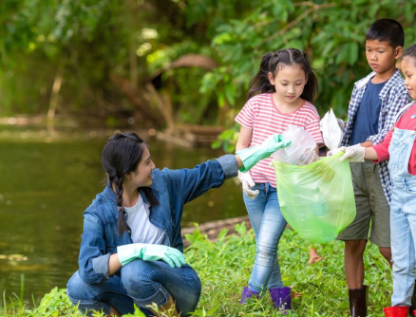
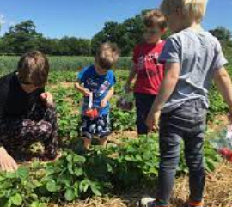
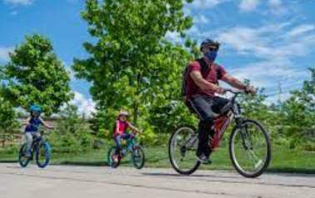
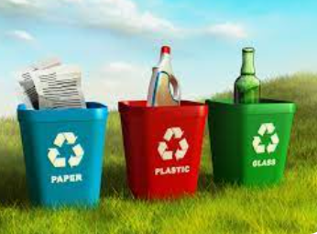
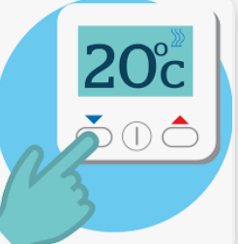
How can we be more sustainable?

Slide 8
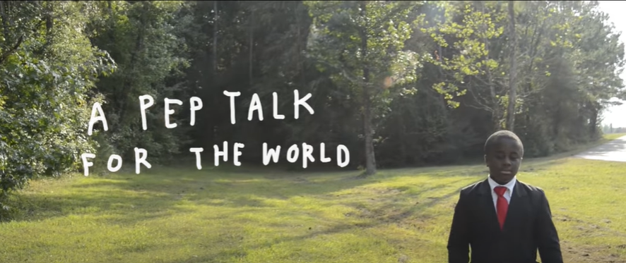
What can we learn from Kid president?
Kid President's Pep Talk for the World - YouTube

Slide 9

Reflection
What are we already doing?
What else could we do in school?

