Slide 1
Bledlow Ridge School
Progression in Phonics
Wednesday 2nd October 2019

Slide 2
What is ‘Phonics’?
Phonics is a method of teaching children to read by associating letters with their sounds.
We can identify 44 phonemes in the English speech but only 26 letters in the alphabet to represent those sounds for the writing process.

Slide 3
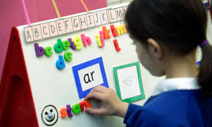
Why do we teach Phonics?
Phonics will help your child to:
Tune into sounds
Recognise letters
Read
Spell
Decode words

Slide 4
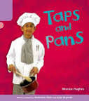
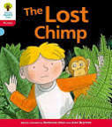
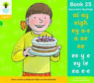
Key Points
Sounds are discrete. Correct pronunciation is very important, we need to ensure the children are taught what we call ‘pure sounds’.
All children learn at a different pace and it can take a while, before children grasp the skills of blending and segmenting.

Slide 5
How do we teach Phonics?
We use the Oxford Reading Tree scheme developed by phonics consultant Debbie Hepplewhite - ‘Floppy’s Phonics Sounds and Letters Programme’.
It is a daily session.
Children learn between 2 to 4 sounds a week. The fifth day is a recap and review day.
The final week of every half term we assess and review.
We revisit any sounds that the majority of children need extra input on. It is vital that they are secure with their sounds.

Slide 6
Progression
Year | Stage | Sounds
R | 1 | Environmental sounds
 | 1+ | s a t p i n m d g o c k ck e u r h b f ff l ll le ss
 | 2 | j v w x y z zz qu ch sh th ng dge ve wh cks tch nk
R/1 | 3 | ai ee igh oa oo ar or ur ow oi ear air er ue ure ture

Slide 7
Progression
Year | Stage | Sounds
R/1 | 4 | ay oy ea ie ow ew ou ir aw eer are ce ea o ed
1/2 | 5 | Eigh ey a a-e ae e ey e-e ie I i-e o oe o-e ough eau se ce ci cy sc st ge gi gy ge el al il u u-e eu u-e o ou ui u ough our au ai war quar ear wor ou our re al s a si ge u ph gh ch ie wa alt ti ci ssi sci gu gue gh ere ier ear ere nn kn gn rr wr rh mm mb mn qu que ore oor oar augh ough

Slide 8
Class R
Recap/Starter:
- Review previously learnt sounds using the flash cards
Main Teaching:
- Introduce new sound
- Discuss the sound
- Name the letter
- Model handwriting
- Introduce the sound through the story and action
- Identify initial sounds
Apply:
- Read words
- Segment and write words
Worksheet
Review:
- Recap, show writing and read high frequency words

Slide 9
Class 1
Starter/Review:
- Introduce new sound
- Discuss the sound, name the letter
- Review previously learnt sounds using the flash cards, pick out new sound taught
Main Teaching/Apply:
- Read words with sound taught, identifying ‘special friends’ first
- Read nonsense words with sound taught
- Write words
Review:
- Recap, show writing and read high frequency words

Slide 10
Class 2
Year 2 phonics builds on the strong foundations of learning laid in the EYFS and Year 1.
Term 1 – Recap the phase 3 - 4 sounds covered in Year 1. However, I do slide some new year 2 sounds in where relevant (i.e. i as y or e as y).
What does a session look like:
Recap/Starter
Main Teaching (practising)
Application of skills (written and/or read)
Term 2/3 – Move into the Year 2 spelling rules which I complete in the same format as the phonics lessons previously.
Year 2 then do a spelling SATs at the end of May. Which can include any of three 50 spelling rules learnt over the three years.
Nessy
https://www.youtube.com/watch?v=o4zlITCMAmE
https://www.youtube.com/watch?v=XTmXI3cjCUA
Alphablocks
https://www.bbc.co.uk/iplayer/episode/b01q0q5c/alphablocks-series-3-23-fair

Slide 11
Phonics Test
Every Year 1 child in the country will be taking the phonics screening check in the same week in June.
The aim of the check is to ensure that all children are able to read by the end of Year 2.
This ‘midpoint check’ will ensure that we have a clear understanding of what the children need to learn in Year 2.

Slide 12
Expectations
The check is very similar to tasks the children will have already completed during phonics lessons.
Children will be asked to ‘sound out’ a word and blend the sounds together e.g. d-o-g - dog
The focus of the check is to see which sounds the children know and therefore the children will be asked to read made up nonsense words.
This is not a reading test!

Slide 13
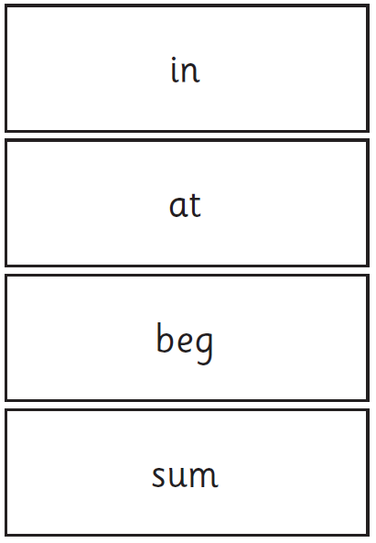
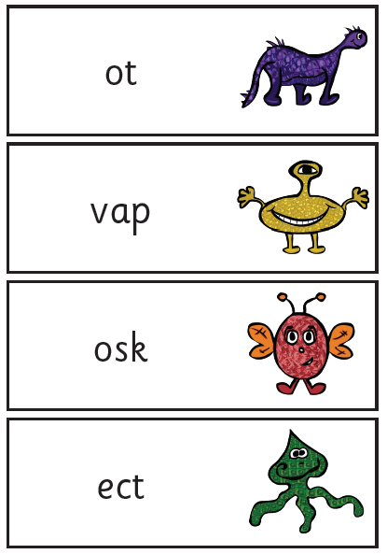
Examples of words

Slide 14
Administration
Miss Grimaldi will conduct all of the screening checks with the children, including those who didn’t pass in Year 2.
The children will complete the check, one to one, in a quiet area of the school.
We are not permitted to indicate to the children at the time whether they have correctly sounded out and/or blended the word.

Slide 15
Results
The school will inform you of whether your child falls below or within a national standard (the threshold being determined by DfE).
Results will be reported in the pupils’ annual reports in July. WT means working towards the required standard. WA means working at the required standard.
If your child does fall below the expected standard, they will re-take the phonics screening check in Year 2.

Slide 16
How can you help?
Encourage your child to ‘sound out’ when reading or writing. Focusing particularly on spotting more unusual sound patterns.
e.g.
Digraph - 2 letters making one sound - cow
Trigraphs - 3 letters making one sound - night
Split digraphs - 2 vowels with a consonant in between - spine - i_e

Slide 17
How can you help?
There are lots of activities that you can do at home to support your child with their reading and writing.
Magnetic letters: Buy magnetic letters for your fridge, or for use with a tin tray. Go through the sounds and make different words encouraging them to sound them out in order to read them, this can also help them with their writing. You can even make some nonsense words.
Whiteboards: Spelling is harder than reading words – praise, don’t criticise. Little whiteboards and pens, and magic boards, are a good way for children to try out spellings and practise their handwriting.
Handwriting: For handwriting children need to be well coordinated through their whole body, not just their hands and fingers. Games that help co-ordination include throwing balls at a target, under-arm and over-arm, and bouncing balls – also skipping on the spot, throwing a Frisbee, picking up pebbles from the beach and throwing them into the sea. Have fun!
Words and Sounds book: Five minutes a day practising the high frequency words and phonemes really helps.

Slide 18
Useful websites
A fantastic App: Mr Thorne does Phonics
http://www.letters-and-sounds.com
http://www.ictgames.com/phonemePopLS-v2.html
http://www.familylearning.org.uk/phonics_games.html
http://www.bbc.co.uk/bitesize/ks1/literacy
http://www.teachyourmonstertoread.com
https://www.bbc.co.uk/cbeebies/shows/alphablocks
https://www.phonicsplay.co.uk/PicnicOnPluto.html
https://www.spellzone.com/games/bouncing_anagram/game-213.htm

Slide 19
Glossary
Phoneme: Smallest identifiable sound of speech.
Vowels: A, E, I, O, and U.
Consonants: Any letter of the alphabet apart from the vowels and ‘y’.
High Frequency Words: Tricky words with unusual spellings e.g. one, was and the.
Grapheme: Written form of a phoneme.
Blending: Building up a word to read a word (decoding).
Segmenting: Breaking up a word to spell a word (encoding).
Digraph- 2 letters making one sound - cow
Trigraphs- 3 letters making one sound - night
Split digraphs- 2 vowels with a consonant in between. Used to be known as the magic e! - spine - i_e

Slide 20
Questions
Thank you for coming,
are there any questions?

